Slide 1
Guide for images annotation-GUI
By Zhang Chenkai

Slide 2

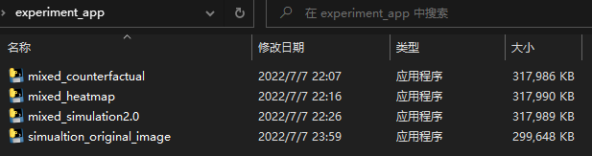
Annotation file
There are two zip file you should unzip:
1. experiment_app.zip
2. 0.zip(“0” maybe replaced by other number, like “1”, “ 2”.., etc.)
ZIP file
ZIP file
After unzipped: There are four applications in experiment _app
Application
Application
Application
Application

Slide 3
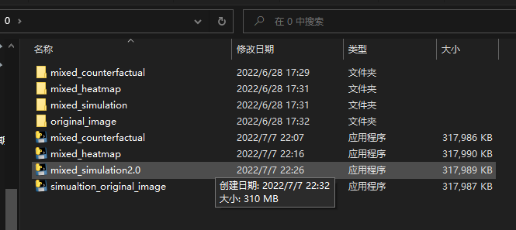
Annotation file
Put these four applications into the folder called “0” (unzipped from the 0.zip).
folder
folder
folder
folder
Application
Application
Application
Application
Then you can start the annotation.
Please note the mixed counterfactual experiment is deleted , and it's not shown in the GitHub version.

Slide 4

Annotation order
Simulation -> Counterfactual -> Original image ->Heatmap
Application
Application
Application
Application

Slide 5
How to start: step 1
1.Double click
Application
Application
Application
Application

Slide 6
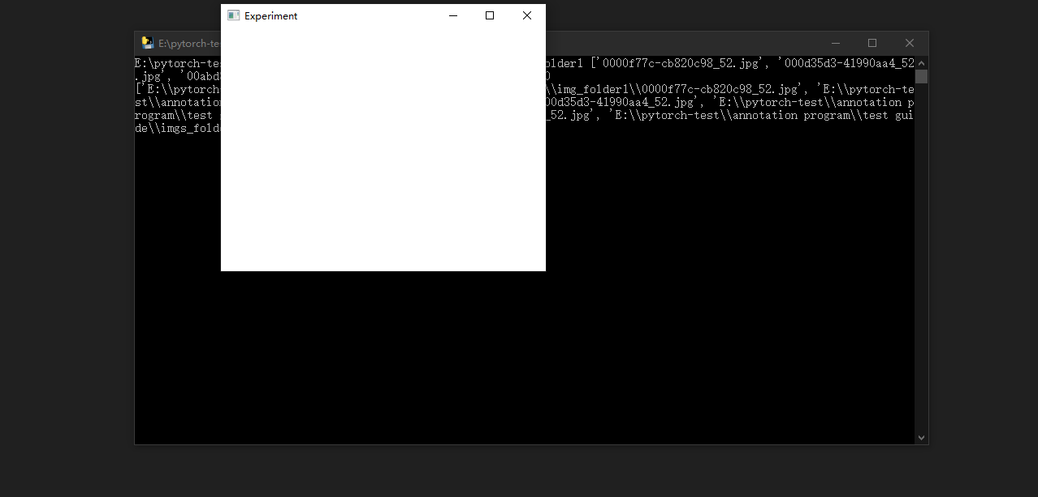
How to start: step 2
2.Maximize this window

Slide 7
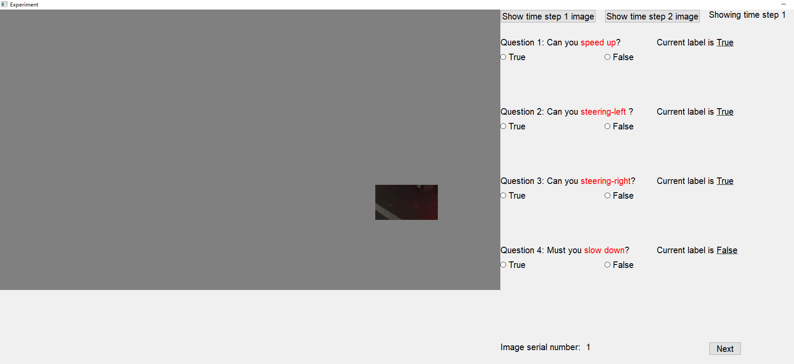
GUI introduction:
Image
Input area
Use these two buttons to say two consecutive images to make the judgment call on the driving actions .
you can push these two buttons or use the keyboard buttons z and c for the first and the second images. Z is for first image , C is for the 2nd image .

Slide 8

GUI introduction:
Image
Save the current data and move on to the next image

Slide 9
GUI introduction:
Image
Input area
Speed Up： “w” Steering Left： “a”
Steering Right： “d” Slow Down： “s”
You can know how many have you done

Slide 10
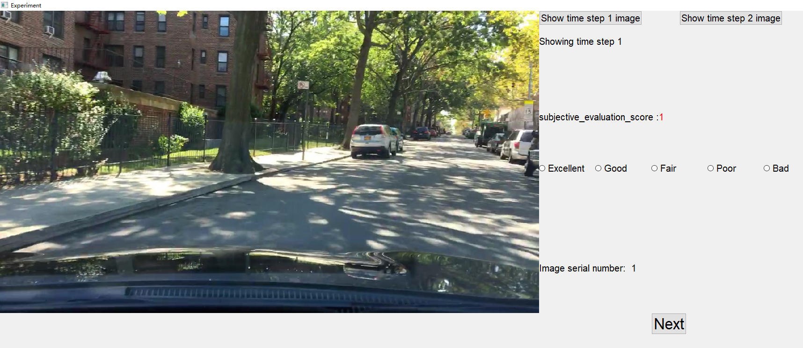
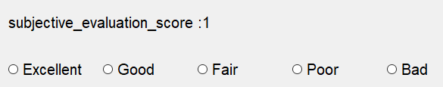
Another GUI introduction:
Image
Once you changed the input, the new score will be shown.
Keyboard
Excellent: “a” Good : “s” Fair: “d” Poor: “f” Bad : “g”

Slide 11
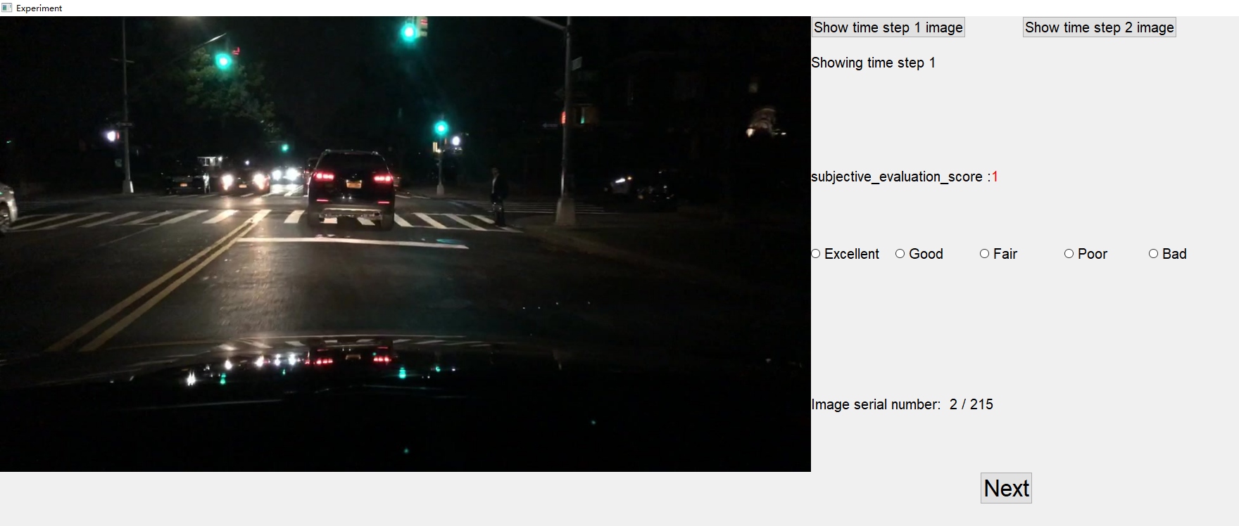
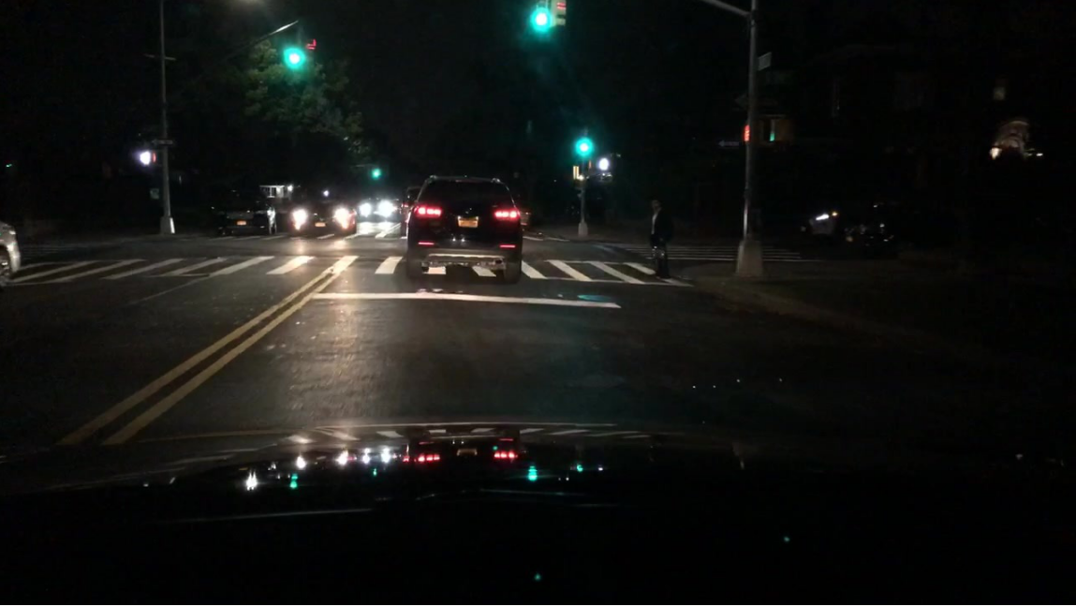
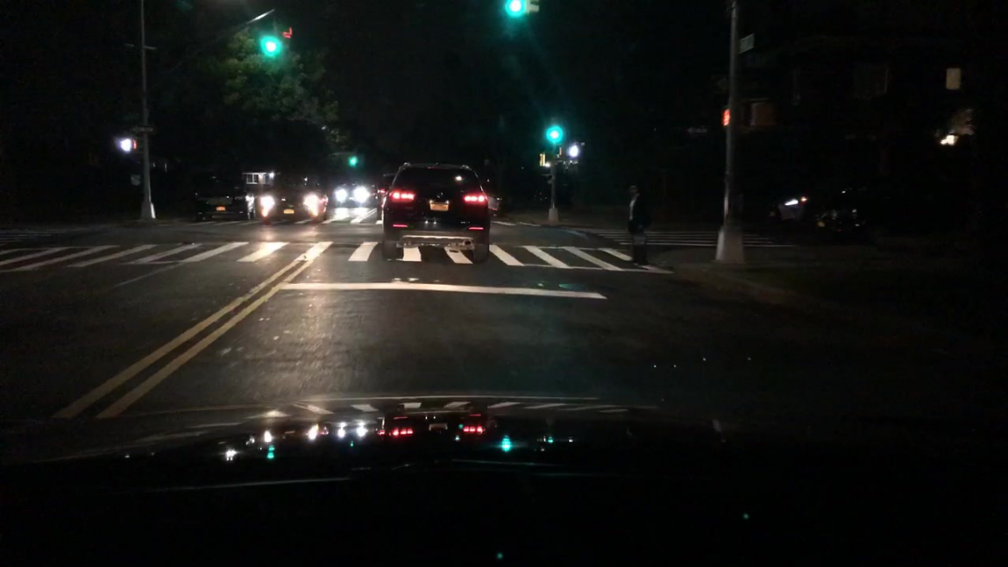
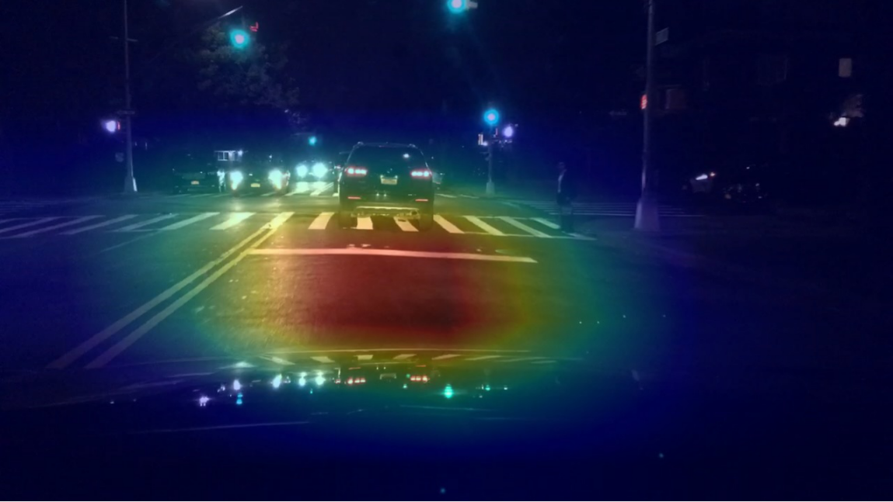
Another GUI introduction:
前の画像を見る時に 、”show time step 1 image”のボタンを押す -キーボード : “z”
次の画像を見る時に 、”show time step 2 image”のボタンを押す -キーボード: “c”
キーボード : “z”
キーボード: “c”

Slide 12

How to input:
Current action status, this will change after clicking the radio buttons
Current action status
Input area
Speed up: False To input this information, we should:
Then, The current action status will change.
Click this button, or pressing “x”.
If you want to change it back to “True”, then you can click the “True” button or pressing “w” again.
If current action status is correct, we can save information and go to the next image by clicking the “Next” button

Slide 13
Extra guide:
In the middle of the work, if we have an emergency that we have to stop the work and shut down the program, it is OK, feel free to do so. The images that we labeled are already been saved, and we can start from where we stopped.
Because I programmed the application could adjust the layout based on the monitor resolution, so the application should be initiated under one monitor status.
This programs involve reading and writing data, when you download and open these application, this operating system probably going to warn you cause this application is not registered to be trusted, but the whole application is programmed by myself, I can guarantee the safety.
Please ignore the warning.
Sometimes, the driving environment will be happening at night, so the image is hard to recognize, feel free to adjust your screen contrast to make sure you can see enough information.

Slide 14
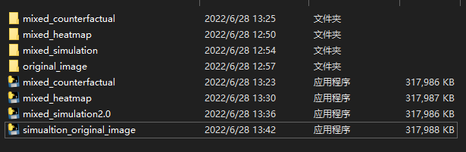
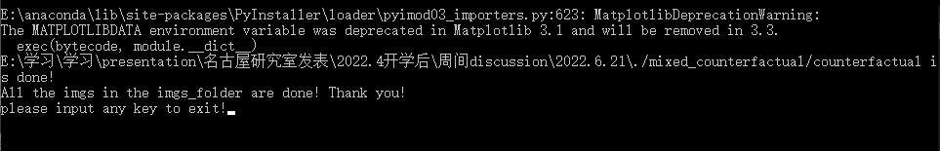
After one task is finished
After one task is finished labeling, the GUI window will be automatically shut down.
If you double click the exe file again.
You will see the following sign:
folder
folder
folder
folder
1.Double click
application
application
application
application

Slide 15
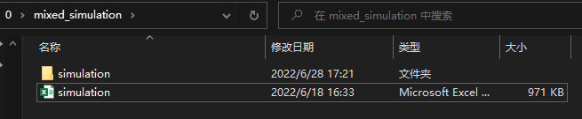
After one task is finished
After you finish one annotation work, you will find a csv file in corresponding folder.
Ex, after you finish the “mixed_simulation”:
You will find a csv file call “simulation.csv”
folder
Csv file

